Slide 1

Chapter-02
Data Science Lifecycle
Data Science Lifecycle
Mr. Zohaib Ahmed (Kaggle Master)
Software Engineering Department
QUEST NAWABSHAH
MS(Data Science)

Slide 2
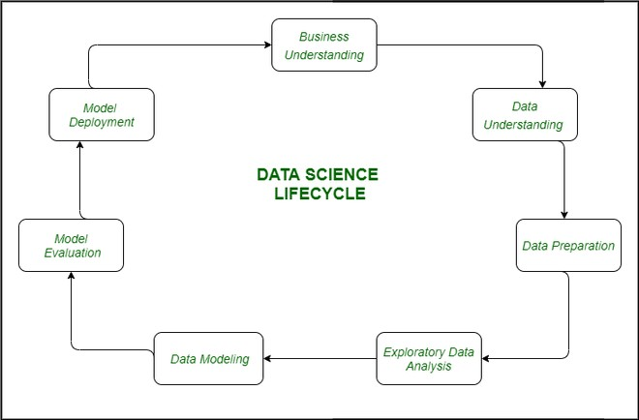
Data Science Lifecycle
Data Science Lifecycle
Mr. Zohaib Ahmed (Kaggle Master)
Software Engineering Department
QUEST NAWABSHAH
MS(Data Science)

Slide 3
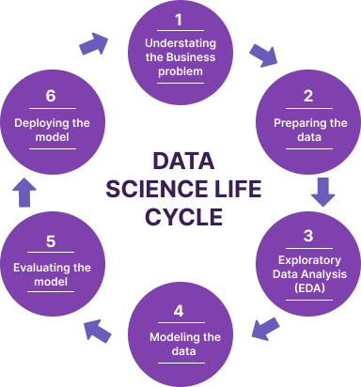
Data Science Lifecycle
Data Science Lifecycle
Mr. Zohaib Ahmed (Kaggle Master)
Software Engineering Department
QUEST NAWABSHAH
MS(Data Science)

Slide 4
1. Problem identification
To be precise, in this step we answer the following questions:
Clearly state the problem to be solved
Reason to solve the problem
State the potential value of the project to motivate everyone
Identify the stakeholders and risks associated with the project
Perform high-level research with your data science team
Determine and communicate the project plan
Data Science Lifecycle
4
Mr. Zohaib Ahmed (Kaggle Master)
Software Engineering Department
QUEST NAWABSHAH
MS(Data Science)

Slide 5
2. Data investigation
In this step, we:
Describe the data
Define its structure
Figure out relevance of data and
Assess the type of data
Data Science Lifecycle
Mr. Zohaib Ahmed (Kaggle Master)
Software Engineering Department
QUEST NAWABSHAH
MS(Data Science)

Slide 6
2. Data investigation
Retrieving Data
🞄 Internal Sources
🞄 External Sources
Do data quality checks now to prevent problems later
Data Science Lifecycle
Mr. Zohaib Ahmed (Kaggle Master)
Software Engineering Department
QUEST NAWABSHAH
MS(Data Science)

Slide 7
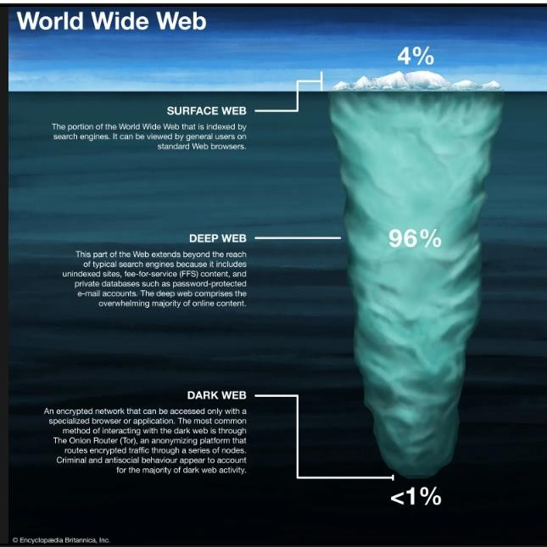
Data Science Lifecycle
Mr. Zohaib Ahmed (Kaggle Master)
Software Engineering Department
QUEST NAWABSHAH
MS(Data Science)

Slide 8
2. Data investigation
Nominal/Categorical data
Binary categorical variable/dichotomous variable
Smoker/Non Smoker, Own a house (Yes/No), HIV positive/HIV negative.
Polytomous variables
Name, Favourite Game, Favourite Drama/Movie,
Hair Colour, Blood Type, Marital Status.
Ordinal Data
Professional Grading, Movie Ratings, T-Shirt Sizes, School Grades
What is One-hot encoding?
Data Science Lifecycle
8
Mr. Zohaib Ahmed (Kaggle Master)
Software Engineering Department
QUEST NAWABSHAH
MS(Data Science)

Slide 9
2. Data investigation
Numerical data
Discrete data
Shoe size, Number of family members. Number of pages in a book, Number of Students in a class, Population of a country…
Continuous data
Weight of newborn babies, Age, Temperature,
Height, Time…
Data Science Lifecycle
Mr. Zohaib Ahmed (Kaggle Master)
Software Engineering Department
QUEST NAWABSHAH
MS(Data Science)

Slide 10
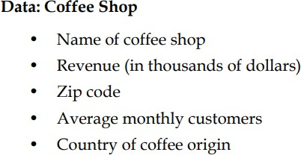
2. Data investigation
Quantitative versus qualitative data
Example – coffee shop data
Data Science Lifecycle
Mr. Zohaib Ahmed (Kaggle Master)
Software Engineering Department
QUEST NAWABSHAH
MS(Data Science)

Slide 11
2. Data investigation
Statistical Distribution of Attributes
🞄 Central Tendency
🞄 Mean (Average)
🞄 Median (Middle)
🞄 Mod (Most Frequent)
🞄 Proximity
🞄 How close/related are different variables
Data Science Lifecycle
Mr. Zohaib Ahmed (Kaggle Master)
Software Engineering Department
QUEST NAWABSHAH
MS(Data Science)

Slide 12
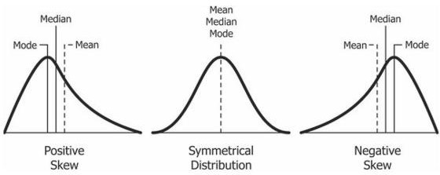
2. Data investigation
Distribution of Data
🞄 Symmetric
🞄 Asymmetric
🞄 Positively Skewed
🞄 Negatively Skewed
Data Science Lifecycle
Mr. Zohaib Ahmed (Kaggle Master)
Software Engineering Department
QUEST NAWABSHAH
MS(Data Science)

Slide 13
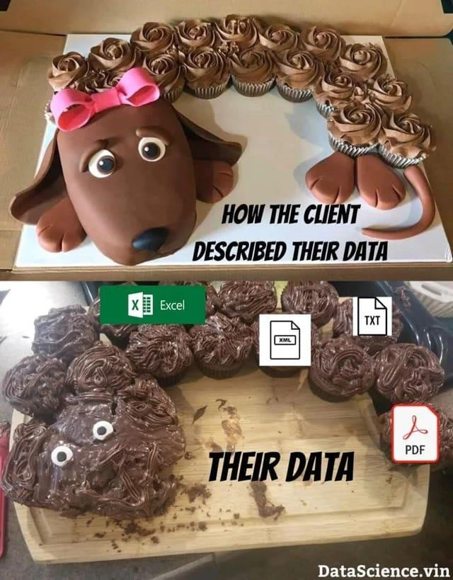
2. Data investigation
Data Science Lifecycle
Mr. Zohaib Ahmed (Kaggle Master)
Software Engineering Department
QUEST NAWABSHAH
MS(Data Science)

Slide 14
3. Pre-processing of data
The actions to be performed at this stage are:
Selection of the applicable data
Data integration by means of merging the data sets
Data cleaning and filtration of relevant information
Treating the lacking values through either eliminating them or imputing them
Treating inaccurate data through eliminating them or correcting
Additionally, test for outliers the use
Data Science Lifecycle
14
Mr. Zohaib Ahmed (Kaggle Master)
Software Engineering Department
QUEST NAWABSHAH
MS(Data Science)

Slide 15
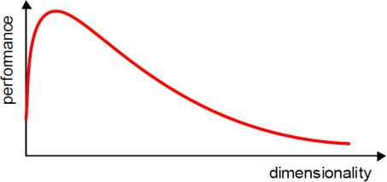
3. Pre-processing of data
Preprocessing
🞄 Cleaning
🞄 Accurate, consistent, missing values are
managed, noise-free
🞄 Integration
🞄 Merge from different sources
🞄 Reduction
🞄 Dimensionality Reduction
Data Science Lifecycle
Mr. Zohaib Ahmed (Kaggle Master)
Software Engineering Department
QUEST NAWABSHAH
MS(Data Science)

Slide 16
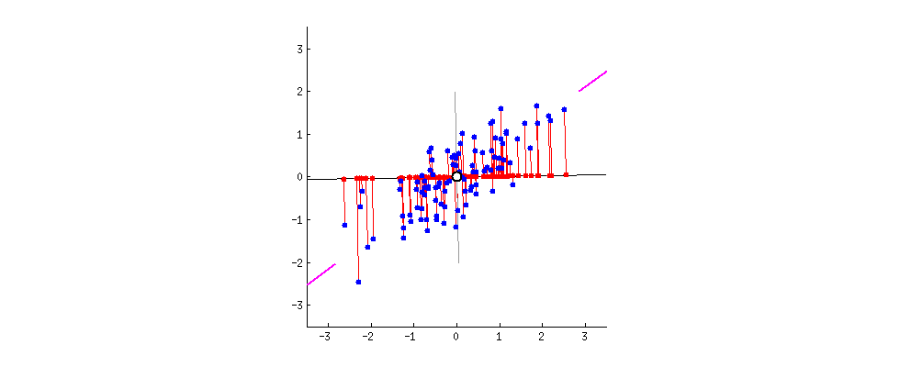
Dimensionality Reduction
Data Science Lifecycle
Mr. Zohaib Ahmed (Kaggle Master)
Software Engineering Department
QUEST NAWABSHAH
MS(Data Science)

Slide 17
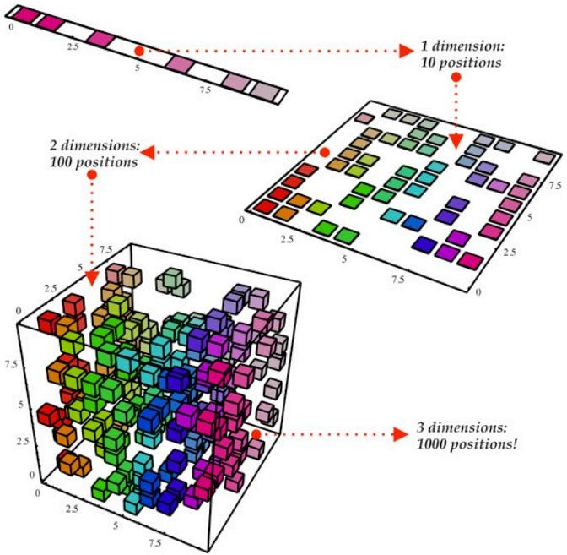
Dimensionality Reduction
Data Science Lifecycle
Mr. Zohaib Ahmed (Kaggle Master)
Software Engineering Department
QUEST NAWABSHAH
MS(Data Science)

Slide 18
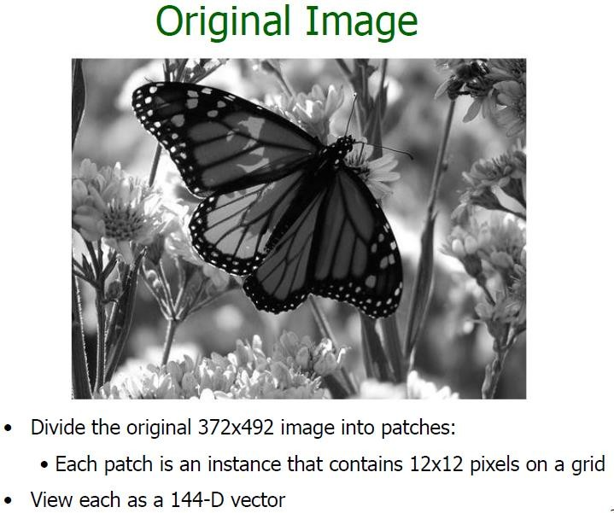
Dimensionality Reduction
Data Science Lifecycle
Mr. Zohaib Ahmed (Kaggle Master)
Software Engineering Department
QUEST NAWABSHAH
MS(Data Science)

Slide 19
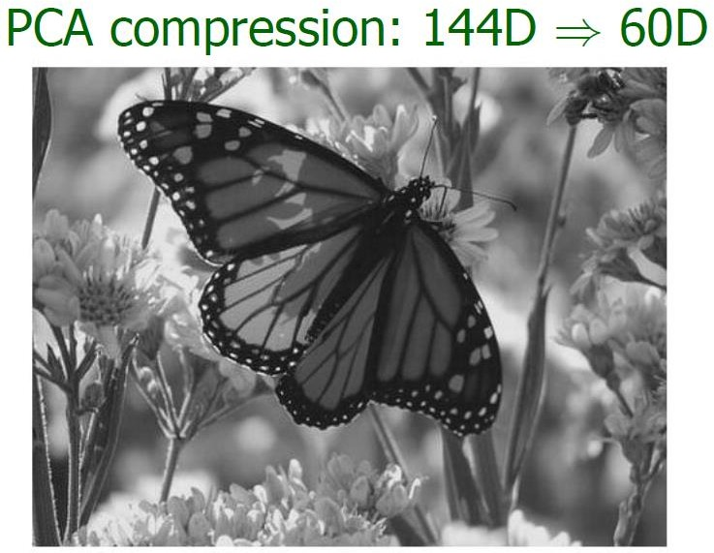
Dimensionality Reduction
Data Science Lifecycle
Mr. Zohaib Ahmed (Kaggle Master)
Software Engineering Department
QUEST NAWABSHAH
MS(Data Science)

Slide 20
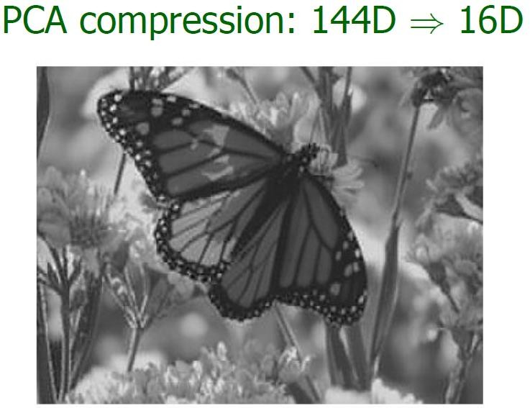
Dimensionality Reduction
Data Science Lifecycle
Mr. Zohaib Ahmed (Kaggle Master)
Software Engineering Department
QUEST NAWABSHAH
MS(Data Science)

Slide 21
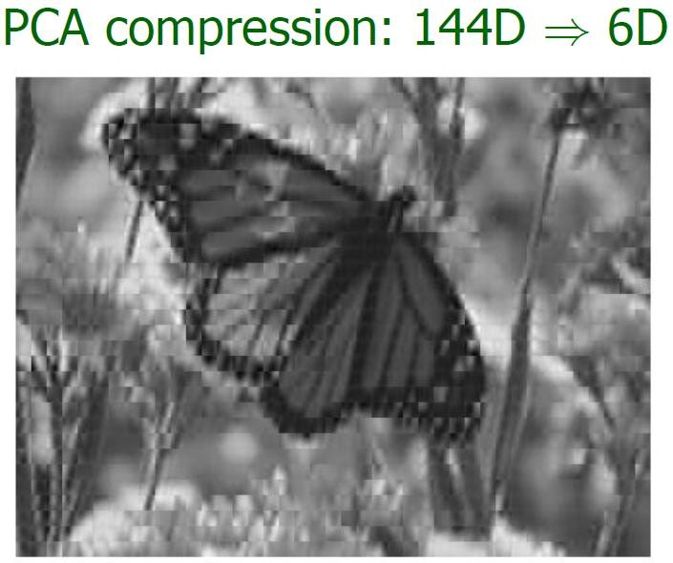
Dimensionality Reduction
Data Science Lifecycle
Mr. Zohaib Ahmed (Kaggle Master)
Software Engineering Department
QUEST NAWABSHAH
MS(Data Science)

Slide 22
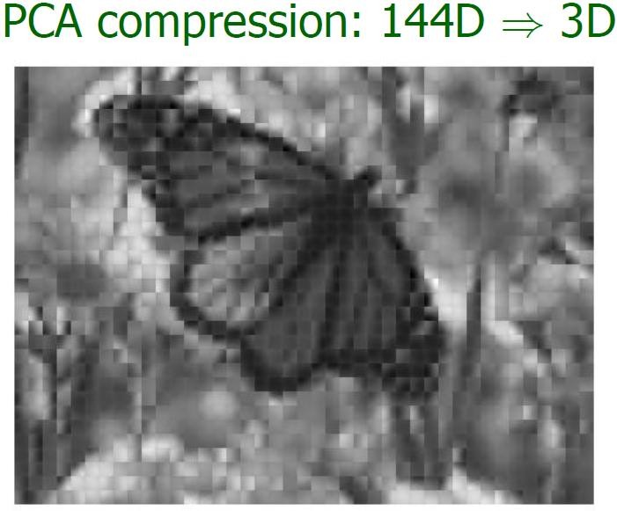
Dimensionality Reduction
Data Science Lifecycle
Mr. Zohaib Ahmed (Kaggle Master)
Software Engineering Department
QUEST NAWABSHAH
MS(Data Science)

Slide 23
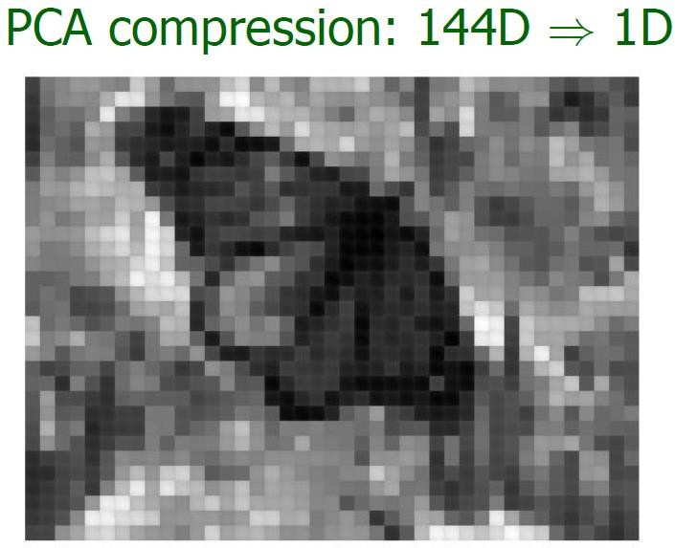
Dimensionality Reduction
Data Science Lifecycle
Mr. Zohaib Ahmed (Kaggle Master)
Software Engineering Department
QUEST NAWABSHAH
MS(Data Science)

Slide 24
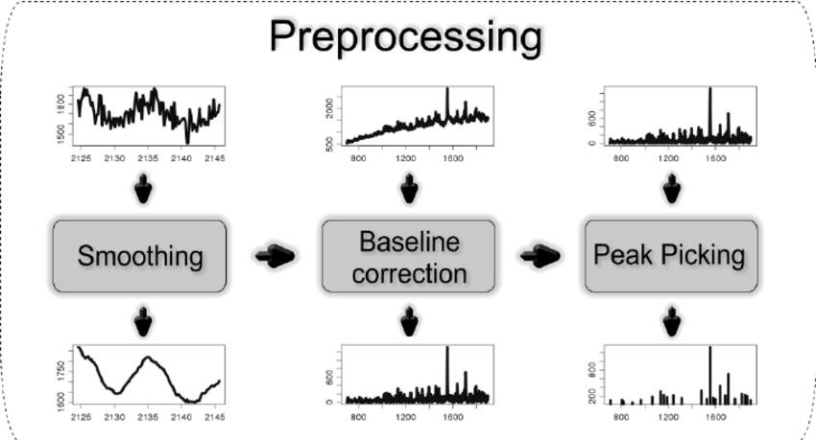
3. Pre-processing of data
Transformation
🞄 Smoothing
Data Science Lifecycle
Mr. Zohaib Ahmed (Kaggle Master)
Software Engineering Department
QUEST NAWABSHAH
MS(Data Science)

Slide 25
3. Pre-processing of data
Transformation
🞄 Feature Engineering
🞄 Feature Extraction
🞄 Discretization (40-50 – Not Apply…) Other examples?
🞄 Normalization (Feature Scaling)
Data Science Lifecycle
Mr. Zohaib Ahmed (Kaggle Master)
Software Engineering Department
QUEST NAWABSHAH
MS(Data Science)

Slide 26
3. Pre-processing of data
Height of the signature
Width of the signature
Height to width ratio
Total time
Total distance covered by pen/finger
6. Average pressure
7. Maximum pressure
8. Total number of pen-ups
9. Total duration for pen-ups
Data Science Lifecycle
27
Mr. Zohaib Ahmed (Kaggle Master)
Software Engineering Department
QUEST NAWABSHAH
MS(Data Science)

Slide 27
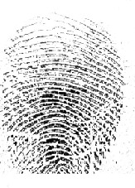



3. Pre-processing of data
Input Image
Orientation = 9
Pixels_per_cell=[4, 4]
Cells_per_block=[2, 2]
Feature Vector Length = 170496
Orientation = 9
Pixels_per_cell=[8, 8]
Cells_per_block=[2, 2]
Length of Feature Vector = 40176
Orientation = 9
Pixels_per_cell=[16, 16]
Cells_per_block=[2, 2]
Length of Feature Vector = 9180
HOG - Histogram of Oriented Gradients (HOG) technique for feature extraction
of Fingerprints
Data Science Lifecycle
2₂8₈
Mr. Zohaib Ahmed (Kaggle Master)
Software Engineering Department
QUEST NAWABSHAH
MS(Data Science)

Slide 28
3. Pre-processing of data
Data Augmentation
🞄 Offline Augmentation
🞄 Online Augmentation
Data Science Lifecycle
Mr. Zohaib Ahmed (Kaggle Master)
Software Engineering Department
QUEST NAWABSHAH
MS(Data Science)

Slide 29
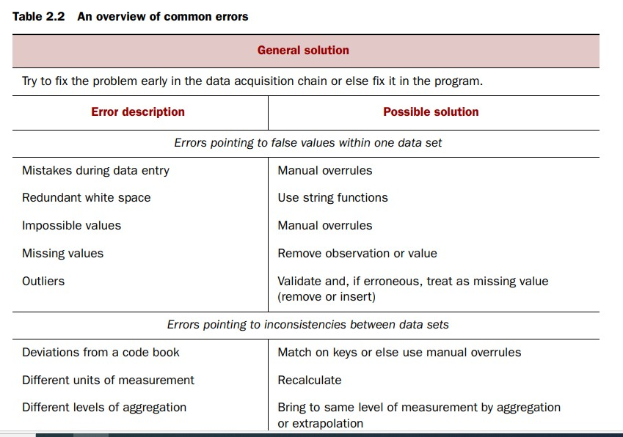
Data Science Lifecycle
Mr. Zohaib Ahmed (Kaggle Master)
Software Engineering Department
QUEST NAWABSHAH
MS(Data Science)

Slide 30
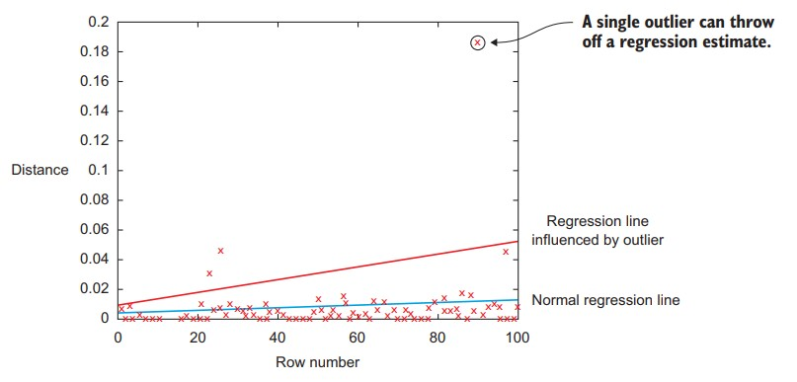
3. Pre-processing of data
Data Science Lifecycle
Mr. Zohaib Ahmed (Kaggle Master)
Software Engineering Department
QUEST NAWABSHAH
MS(Data Science)

Slide 31
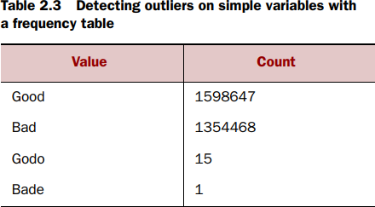
3. Pre-processing of data
Data Science Lifecycle
Mr. Zohaib Ahmed (Kaggle Master)
Software Engineering Department
QUEST NAWABSHAH
MS(Data Science)

Slide 32
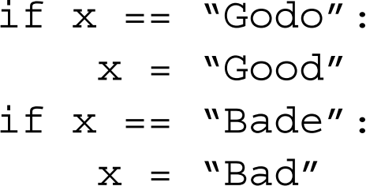
3. Pre-processing of data
Data Science Lifecycle
Mr. Zohaib Ahmed (Kaggle Master)
Software Engineering Department
QUEST NAWABSHAH
MS(Data Science)

Slide 33
3. Pre-processing of data
REDUNDANT WHITESPACE
🞄 strip() function
FIXING CAPITAL LETTER MISMATCHES
🞄 .lower()
IMPOSSIBLE VALUES AND SANITY CHECKS
🞄 check = 0 <= age <= 120
OUTLIERS?
Data Science Lifecycle
Mr. Zohaib Ahmed (Kaggle Master)
Software Engineering Department
QUEST NAWABSHAH
MS(Data Science)

Slide 34
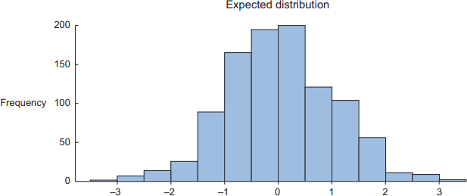
3. Pre-processing of data
Data Science Lifecycle
Mr. Zohaib Ahmed (Kaggle Master)
Software Engineering Department
QUEST NAWABSHAH
MS(Data Science)

Slide 35
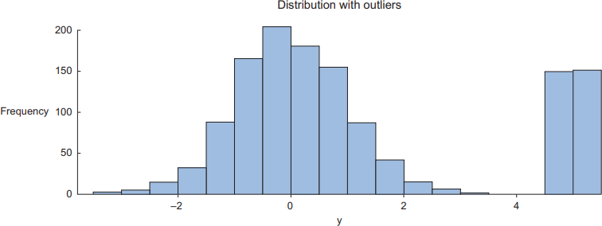
3. Pre-processing of data
Data Science Lifecycle
Mr. Zohaib Ahmed (Kaggle Master)
Software Engineering Department
QUEST NAWABSHAH
MS(Data Science)

Slide 36
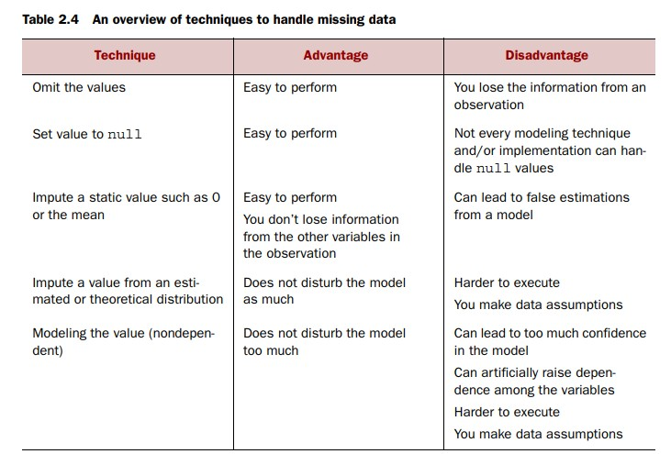
Data Science Process
Data Science Lifecycle
Mr. Zohaib Ahmed (Kaggle Master)
Software Engineering Department
QUEST NAWABSHAH
MS(Data Science)

Slide 37
3. Pre-processing of data
DIFFERENT UNITS OF MEASUREMENT
DIFFERENT LEVELS OF AGGREGATION
Correct errors as early as possible
Combining data from different data sources
THE DIFFERENT WAYS OF COMBINING DATA
Data Science Lifecycle
38
Mr. Zohaib Ahmed (Kaggle Master)
Software Engineering Department
QUEST NAWABSHAH
MS(Data Science)

Slide 38
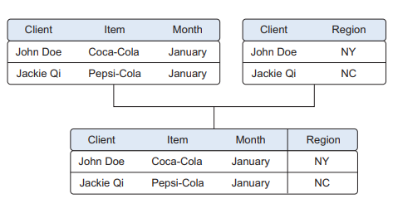
3. Pre-processing of data
JOINING TABLES
Data Science Lifecycle
Mr. Zohaib Ahmed (Kaggle Master)
Software Engineering Department
QUEST NAWABSHAH
MS(Data Science)

Slide 39
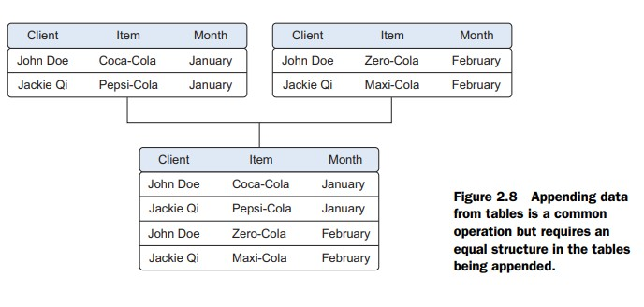
3. Pre-processing of data
APPENDING TABLES
Data Science Lifecycle
Mr. Zohaib Ahmed (Kaggle Master)
Software Engineering Department
QUEST NAWABSHAH
MS(Data Science)

Slide 40
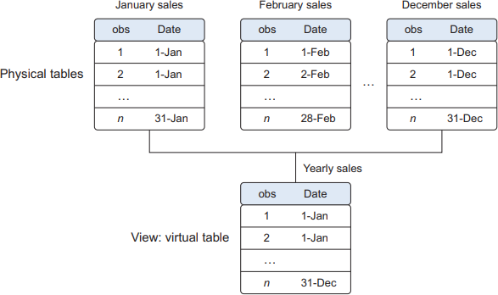
3. Pre-processing of data
USING VIEWS TO SIMULATE DATA JOINS AND APPENDS
Data Science Lifecycle
Mr. Zohaib Ahmed (Kaggle Master)
Software Engineering Department
QUEST NAWABSHAH
MS(Data Science)

Slide 41
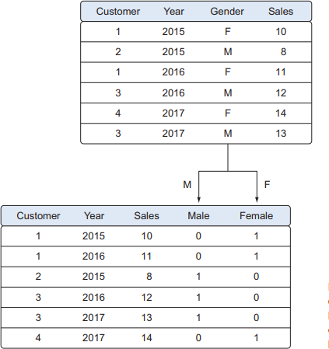
3. Pre-processing of data
Transforming data
🞄 TURNING VARIABLES INTO DUMMIES
Data Science Lifecycle
Mr. Zohaib Ahmed (Kaggle Master)
Software Engineering Department
QUEST NAWABSHAH
MS(Data Science)

